Slide 1
Python Data Science Internship
Week -1

Slide 2
Task 1
Database - Form Integration
Saving Data into Database
Display Saved Data

Slide 3
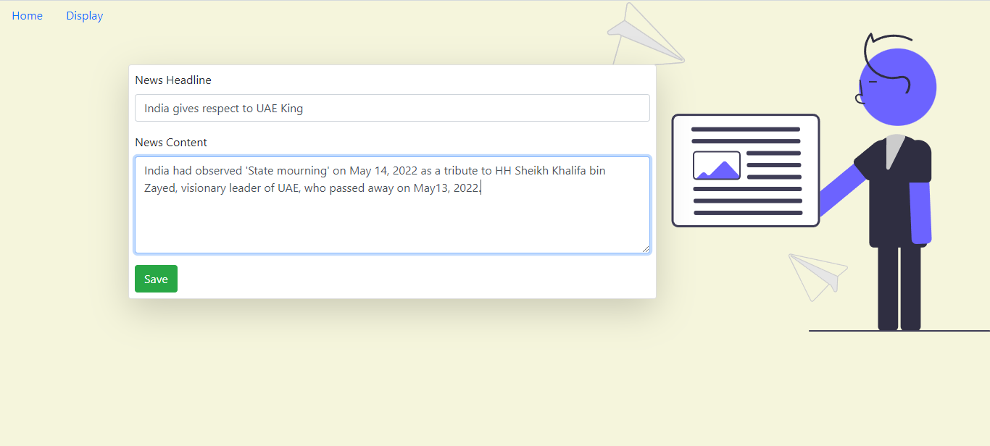
Database - Form Integration

Slide 4
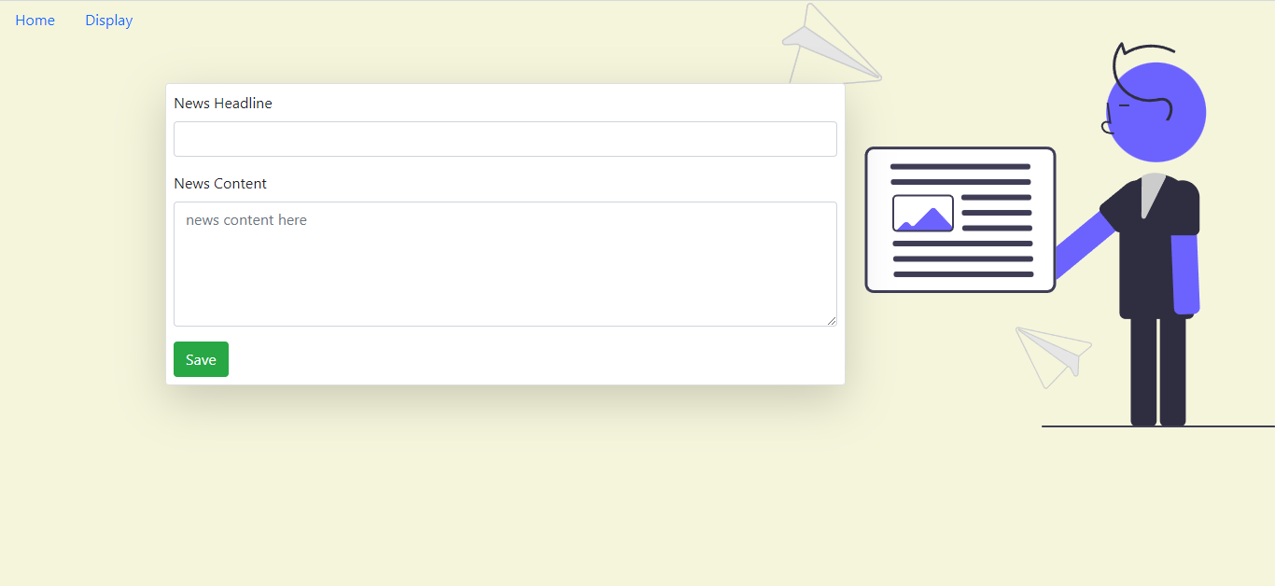
Saving Data to Database

Slide 5
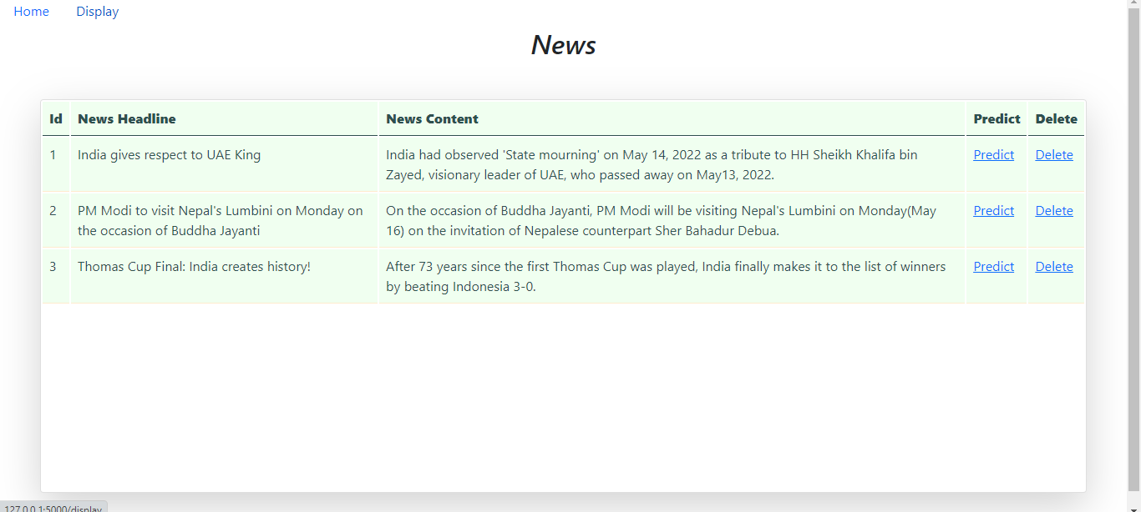
Displaying Saved Data

Slide 6
Task 2
Complete Pandas Tutorial on Kaggle

Slide 7
Thank You

